Slide 1

ROLE OF SELF EFFICACY AND ENTREPRENEURIAL INCLINATION OF GRADUATING STUDENTS

Slide 2


A
BOUT OUR TEAM
Abdullah Ejaz
Ahmed Nasir
Baber Ali
Fahad
Faizan
Rayyan Kamran
Talha Masood

Slide 3


INTRODUCTION
What is Self efficacy?
Concept by Albert Bandura
Empowered Belief
Confident Capability
Resilient Determination

Slide 4

INTRODUCTION
Understanding Entrepreneurial Inclination
Pursuing entrepreneurial endeavors
Ambitious Drive
Proactive Vision
Entrepreneurial Interest

Slide 5

INTRODUCTION
Association between Self Efficacy and Entrepreneurial Inclination
Self-Confidence Boosts
Entrepreneurial Career Path
Reduced Business Desire
Moderates Entrepreneurial Behavior

Slide 6

INTRODUCTION
Impact on Entrepreneurial Inclination
Role Model Impact
Positive Experiences
Support Systems
Cultural Influence

Slide 7
PURPOSE OF SURVEY
Investigate Self-Efficacy Impact
Tackle Entrepreneurial Challenges
PURPOSE
Boost Confidence in Students
Explore Student Attitudes
Examine Successful Interventions
Encourage Entrepreneurial Belief

Slide 8

THE PROBLEM TO RESOLVE
Self-Doubt Hinders Aspirations
Lack of Self-Efficacy
Hampered Confidence
Reduced Entrepreneurial Motivation
Limited Business Creation
Stunted Personal Development

Slide 9



HYPOTHESES
Self Efficacy boosts Confidence
Low Self-Efficacy Hinders EI
Hampered Confidence
Self-Efficacy Enhances Entrepreneurial Mindset
Education and Support Enhance EI

Slide 10

VARIABLES
SELF EFFICACY
Confidence to Achieve Goals
Independant Variable
Entrepreneurial Inclination
Drive for entrepreneurial opportunities
Dependant Variable

Slide 11

METHOD
POPULATION
5th and 7th Semester Students
Mostly near Graduation
SAMPLE
50+ STUDENTS
90% Male Population

Slide 12
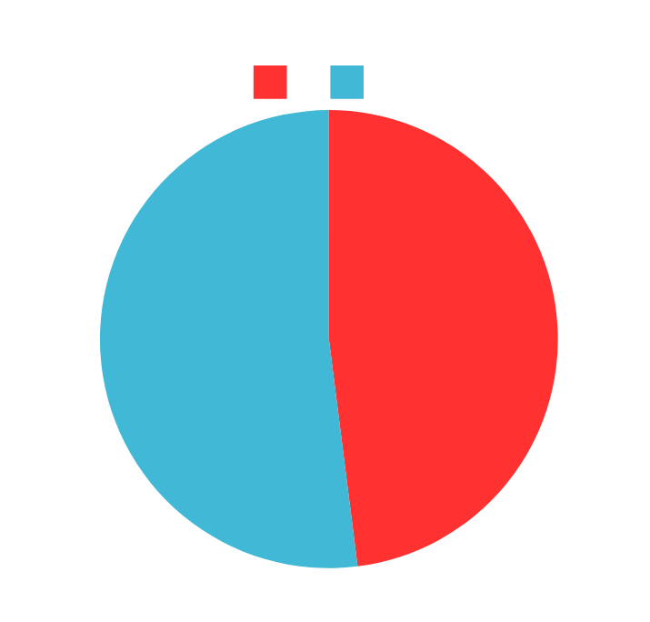
METHODOLOGY
SAMPLING TECHNIQUE
Online Survey
TOOL OF SURVEY
25 Questions
Likert Scale
1-5 Response Categories

Slide 13

INTERNATIONAL RESEARCH 1
STUDY OVERVIEW
Investigate Self-Efficacy Impact
Analyze Entrepreneurial Education Effects
Chinese Students
THEORETICAL FRAMEWORK
Uses Theory of Planned Behavior

Slide 14
INTERNATIONAL RESEARCH 1
KEY FINDINGS
Education Boosts Entrepreneurial Inclination
Self Efficacy Enhances Entrepreneurial Inclination
PRACTICAL IMPLICATIONS
Education Alone Insufficient

Slide 15
INTERNATIONAL RESEARCH 1
RECOMMENDATIONS
Focus On Self Efficacy
Practical Workshops Suggested
LIMITATION
Regional Data Limitation

Slide 16
INTERNATIONAL RESEARCH 2
STUDY OVERVIEW
Examine Self-Efficacy and EI
Sample of Malaysian Engineering Students
THEORETICAL FRAMEWORK
Supports Bandura's Theory

Slide 17
INTERNATIONAL RESEARCH 2
KEY FINDINGS
Moderate Self-Efficacy
High Entrepreneurial Tendency
PRACTICAL IMPLICATIONS
Emphasis on Entrepreneurial Education

Slide 18
INTERNATIONAL RESEARCH 2
RECOMMENDATIONS
Hands-On Training Suggested
Enhance Self-Efficacy
LIMITATION
No Limitations mentioned

Slide 19
NATIONAL RESEARCH 1
STUDY OVERVIEW
Self-Efficacy's Role in EI
Pakistani Students
Focus on Graduating Students
THEORETICAL FRAMEWORK
Mediation by Self-Efficacy

Slide 20
NATIONAL RESEARCH 1
KEY FINDINGS
Education's Sequential Effect
High Self-Efficacy's Impact
PRACTICAL IMPLICATIONS
Cultural Context in Pakistan

Slide 21
NATIONAL RESEARCH 1
RECOMMENDATIONS
Mentorship and Learning
Support for Training Programs
LIMITATION
No Limitations mentioned

Slide 22
NATIONAL RESEARCH 2
STUDY OVERVIEW
Focus on Commerce Students
Influence of Self-Efficacy on EI
THEORETICAL FRAMEWORK
Supports Bandura's Theory

Slide 23
NATIONAL RESEARCH 2
KEY FINDINGS
High Entrepreneurial Self-Efficacy (ESE) Predicts Entrepreneurial Inclinations (EI)
ESE Mediates Entrepreneurial Education (EE) and EI
PRACTICAL IMPLICATIONS
Challenges in Poor Countries

Slide 24
NATIONAL RESEARCH 2
RECOMMENDATIONS
Experiential Learning Techniques
Mentoring and Training
LIMITATION
No Limitations mentioned

Slide 25

SURVEY DEMOGRAPHICS
50+ Respondents
Ages 19-25
90% Male Participants
Fifth & Seventh Semesters

Slide 26

DATA ANALYTICS
Mean And Standard Deviation
Correlation
Result Demonstration

Slide 27
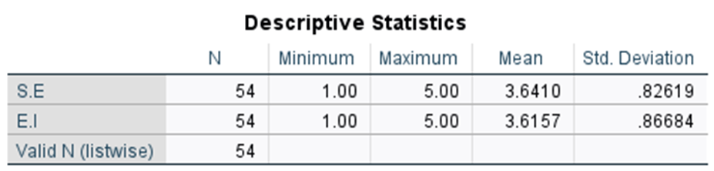
MEAN AND STANDARD DEVIATION
S.E Mean = 3.6410
Responders = 54
S.E Standard Deviation = 0.82619
Minimum = 1
E.I Mean = 3.6157
Maximum = 5
E.I Standard Deviation = 0.86684

Slide 28
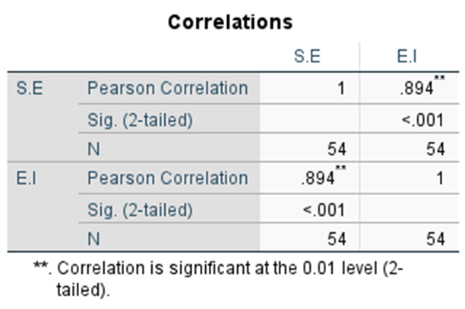
CORRELATION ANALYSIS
PEARSON CORRELATION
Correlation = 0.894
INTERPRETATION
Linear Relation
High relation (0.8 - 1.0)

Slide 29

CONCLUSION
Positive Relationship Found
Self-Efficacy Boosts EI
Graduates Benefit Greatly
Higher Self-Efficacy, Higher EI
Confident Entrepreneurial Mindset

Slide 30
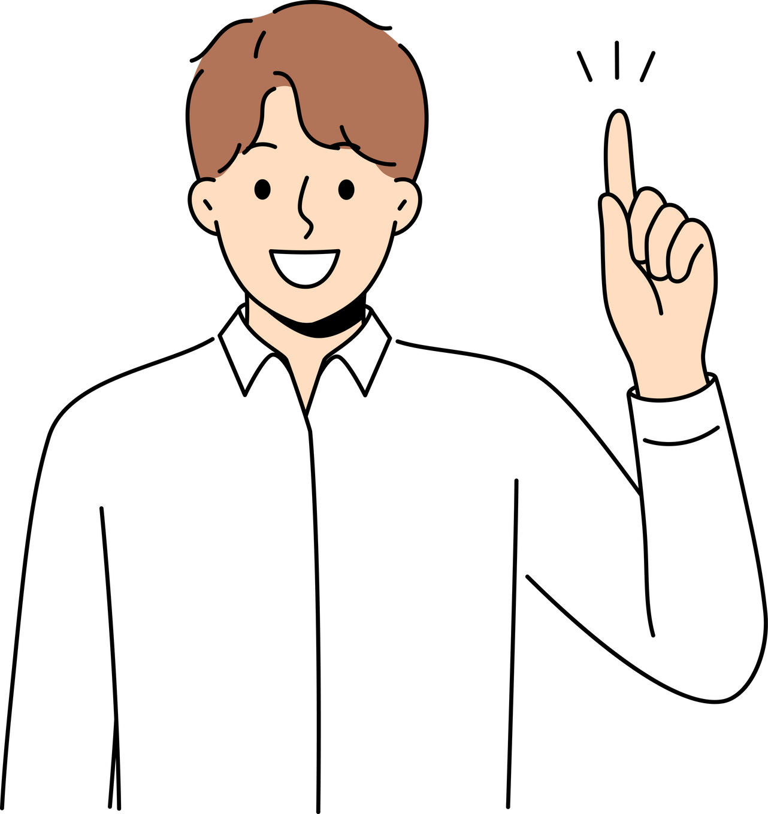
RECOMMENDATIONS
Set Attainable Goals
Encourage Self-Reflection
Promote Growth Mentality
Implement Entrepreneur Programs

Slide 31
RECOMMENDATIONS
Interactive Seminars Needed
Foster Support Networks
Boost Self-Efficacy
Use Mindfulness Techniques

Slide 32
THANK YOU! ANY QUESTIONS?

Slide 33
GOOGLE IS THE BEST PLACE!

